Slide 1


Building Enterprise grade AI Systems Solo with LLMs & AWS
Soujanya Vullam
AUGUST 11-13, 2025
MGM GRAND, LAS VEGAS
Notes:
Hi everyone, thanks for joining me here.

Slide 2
Can a solo developer build enterprise-grade AI systems efficiently?
Notes:
Can a Solo developer build enterprise -grade AI systems efficiently? This is the question that drove my work over the last few months. As a solo developer, I wanted to know if it was possible to go beyond a lightweight prototype and build a secure, scalable, and robust AI system that serves a purpose efficiently. Today I am going to go over a use case that I built regarding the same.

Slide 3

What Makes a System Enterprise-Grade?
Modularity
Scalability
Reliability
Security
Flexibility
Observability
Reusability
Cost-Effectiveness
Maintainability
Reusability
Testability
Evals
Notes:
Firstly What makes a system enterprise grade?
Enterprise Grade system isn’t just about functionality, it is about building robust, reliable, scalable application that is ready for business needs. These are the system design principles of an enterprise grade system.
Im not going into details of each of these in the interest of time. However, I would like to go over Observability and Evals in the context of AI systems Observability in AI systems is to understand the internal state of a system by analyzing the data it generates like metrics, logs, and traces, to provide insights into how AI models make decisions, perform over time, and conform to security and compliance
Evals - are frameworks used to assess the performance of AI systems against a predefined criteria. Unlike traditional software testing with clear pass/fail scenarios, AI evals measure quality and effectiveness across multiple dimensions like accuracy, relevance, coherence, completeness, helpfulness, and safety. They are useful for ensuring reliability, identifying areas for improvement, and enabling informed iterations throughout the AI development lifecycle
=======
Modularity: Break the system into small, independent pieces that are easy to build, and update.
Scalability: A system that automatically grows and shrinks with traffic to not wasting resources.
Reliability: Built-in backups and disaster recovery.
Security: Encrypt all data always and control who gets into the system.
Flexibility: dont tightly couple a system to specific technology, so we can evolve based on business needs.
Reusability: build common components that one can reuse, saving time and ensuring consistency.
Cost-Effectiveness: Achieving it by using pay-as-you-go services meaning we only pay for the exact compute time and storage we use, so there are no wasted dollars on idle servers.
Maintainability: Adopting infrastructure as code, CICD, and documenting the system, making it easy for anyone to understand, manage, and update the code.
Testability: Design components so they can be isolated and tested thoroughly.
in enterprise AI systems Observability is to understand the internal state of a system by analyzing the data it generates like metrics, logs, and traces, to provide insights into how AI models make decisions, their performance over time, and their security and compliance
Evals - are frameworks used to assess the performance of AI systems against a predefined criteria. Unlike traditional software testing with clear pass/fail scenarios, AI evals measure quality and effectiveness across multiple dimensions like accuracy, relevance, coherence, completeness, helpfulness, and safety. They are useful for ensuring reliability, identifying areas for improvement, and enabling informed iterations throughout the AI development lifecycle
====
Modularity: Separate the system into independent microservices (Lambda functions) for easier development and deployment.
Scalability: Handle increasing workloads automatically using serverless auto-scaling and a global CDN for high traffic.
Reliability: Ensure consistent performance with built-in fault tolerance, retries, and comprehensive error handling.
Security: Protect data with multi-layered security, including encryption, robust authentication (Cognito), and network isolation (VPC).
Flexibility: Easily adapt to new technologies and use cases with a design that is extensible and avoids vendor lock-in.
Reusability: Build components and templates (Lambda Layers, CloudFormation) for consistency and to save development time.
Cost-Effectiveness: Maximize value with a pay-per-use serverless model and optimize resources to eliminate idle costs.
Maintainability: Simplify long-term operations with Infrastructure as Code and a type-safe language (TypeScript) for predictable updates.
Testability: Ensure quality by designing modular components that are easy to test in isolation with mocks and dedicated test utilities.
==

Slide 4
Use case: Epic Q&A
Purpose: Answer questions about a context - a book or a codebase
AI-powered Q&A web application:
Users ask natural language questions
Receive intelligent, context-aware responses about large books, documentation and code base
Notes:
This is my Usecase: Epic Q&A
Questions play an important role in the world of learning, whether for a student, a new hire, or any curious mind - we all have questions. Good news is now we have AI to answer all our questions - In this session, I'll share how I independently designed and deployed an AI Q&A platform called Epic using modern cloud-native architecture.
Epic is a full-stack web application that allows users to upload books, documents and code and ask complex natural language questions about them. The platform provides intelligent, context-aware answers. My goal today is to share the real-world techniques I used to accelerate developer velocity, reduce infrastructure costs, and build production-ready applications that are scalable and secure and serve a purpose

Slide 5
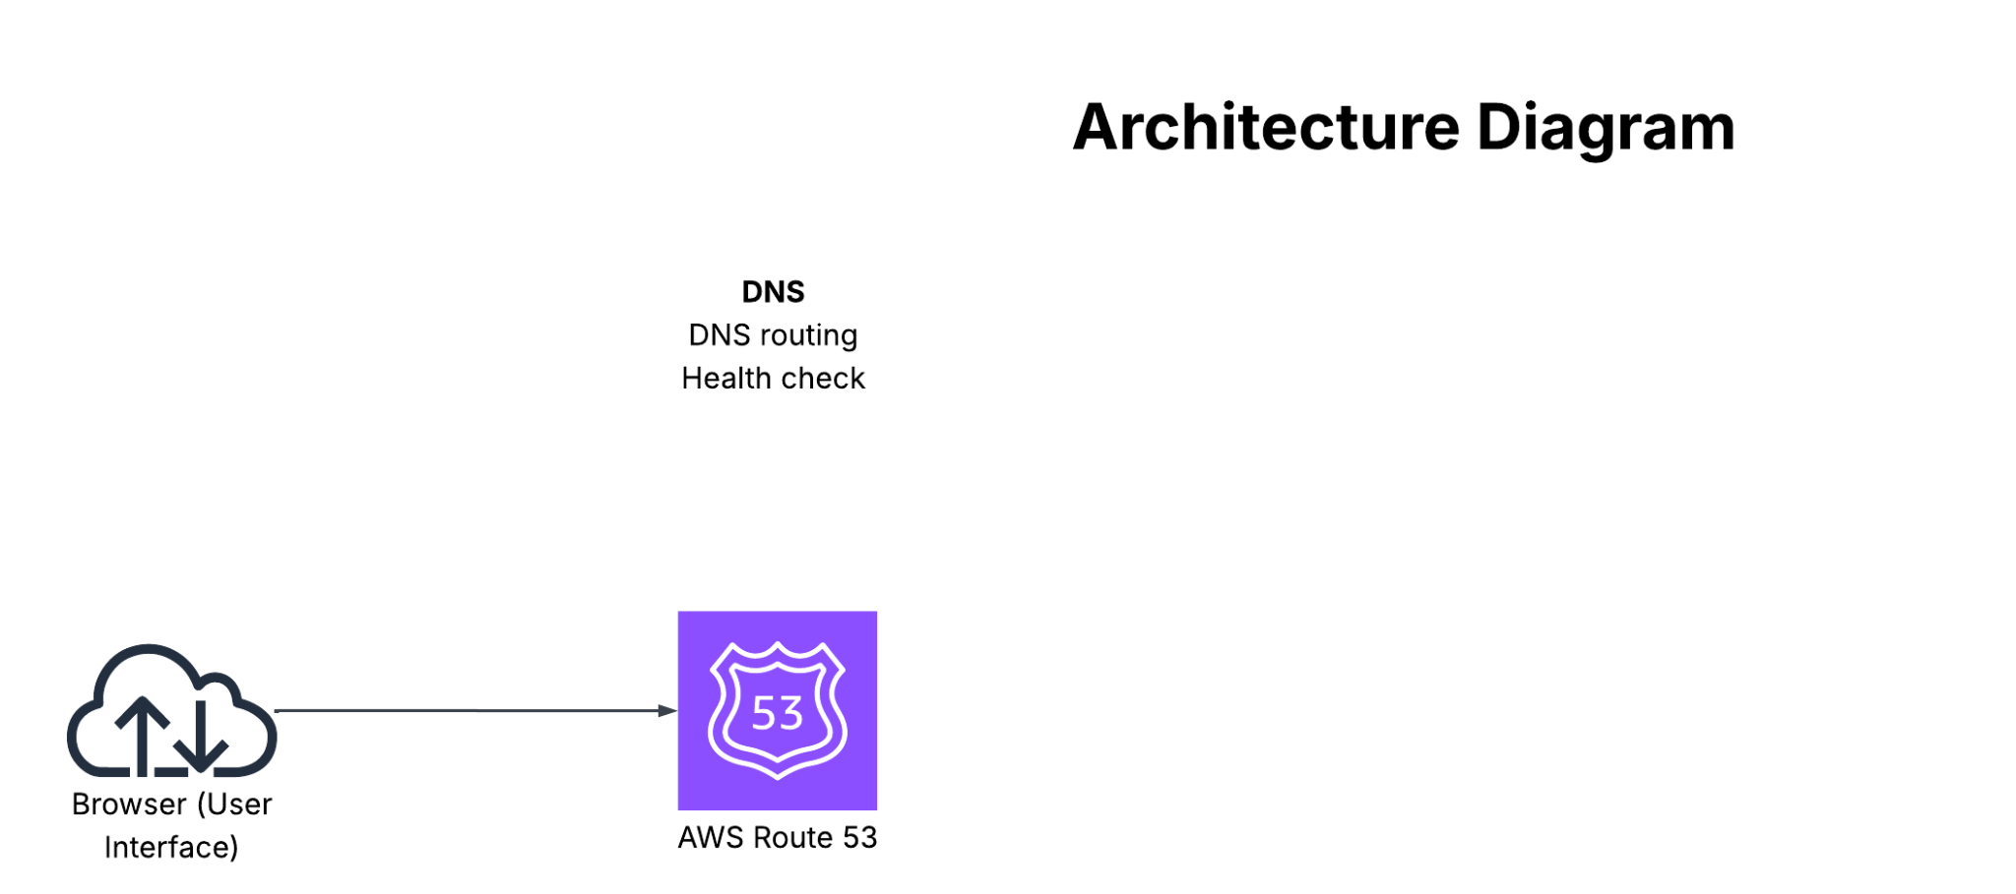
Notes:
lets look into the architecture
I considered all the system design principles for enterprise grade quality and came up with this architecture
When user logs in to the epic library page -
Route53 receives user request and routes to the CDN

Slide 6
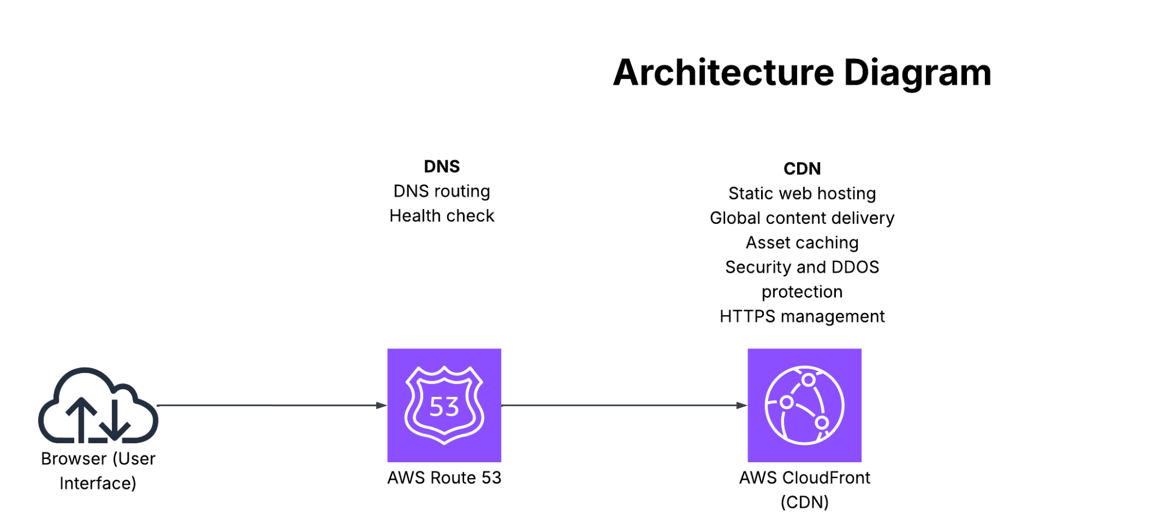
Notes:
CDN (CloudFront) serves static frontend files and caches content

Slide 7
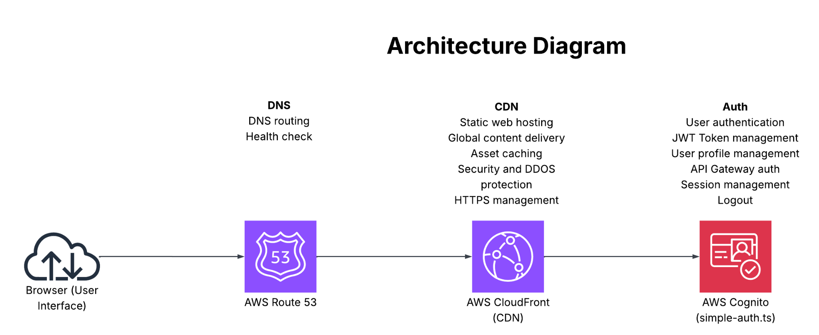
Notes:
Frontend authenticates user through Cognito to get JWT token

Slide 8
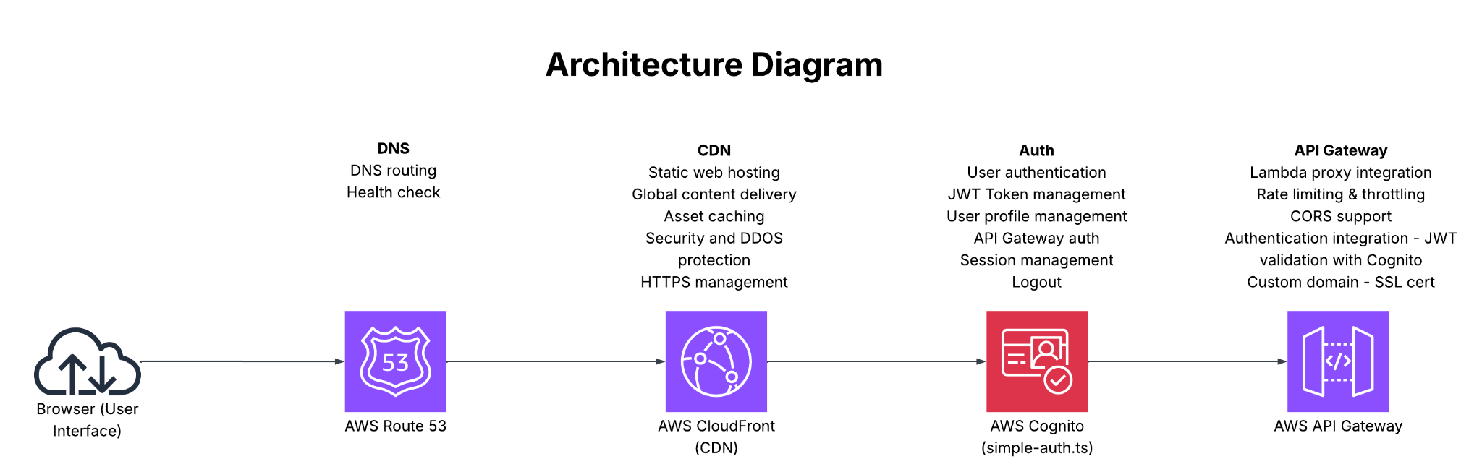
Notes:
API Gateway receives API requests and validates JWT tokens in the header with Cognito

Slide 9
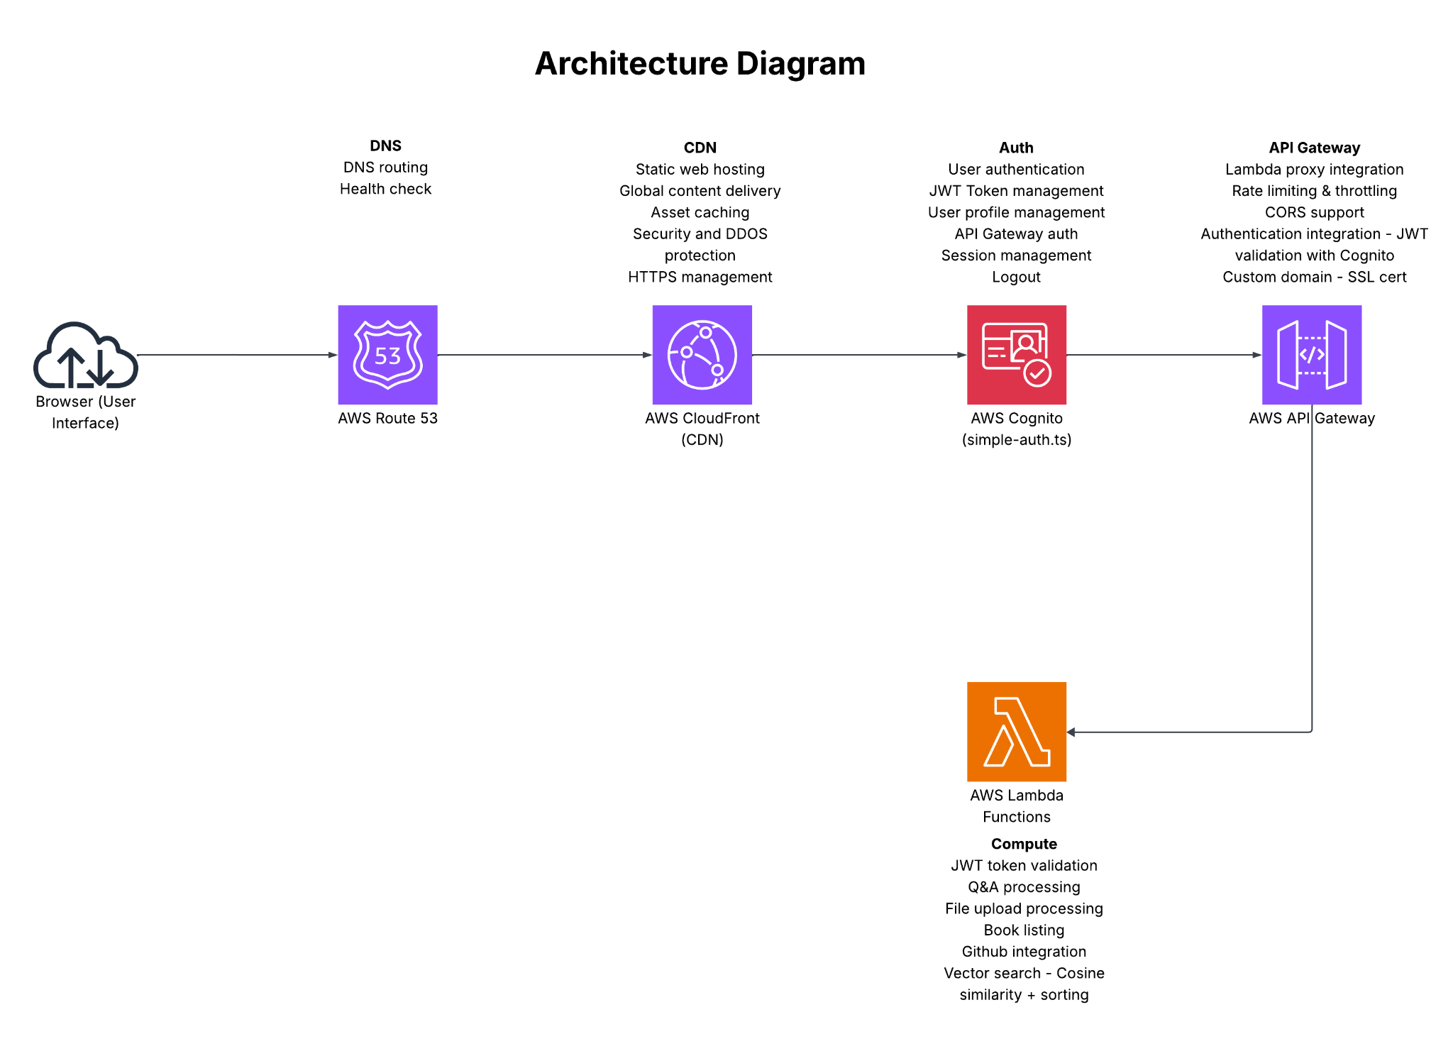
Notes:
Appropriate Lambda functions are triggered by API Gateway based on the flow

Slide 10
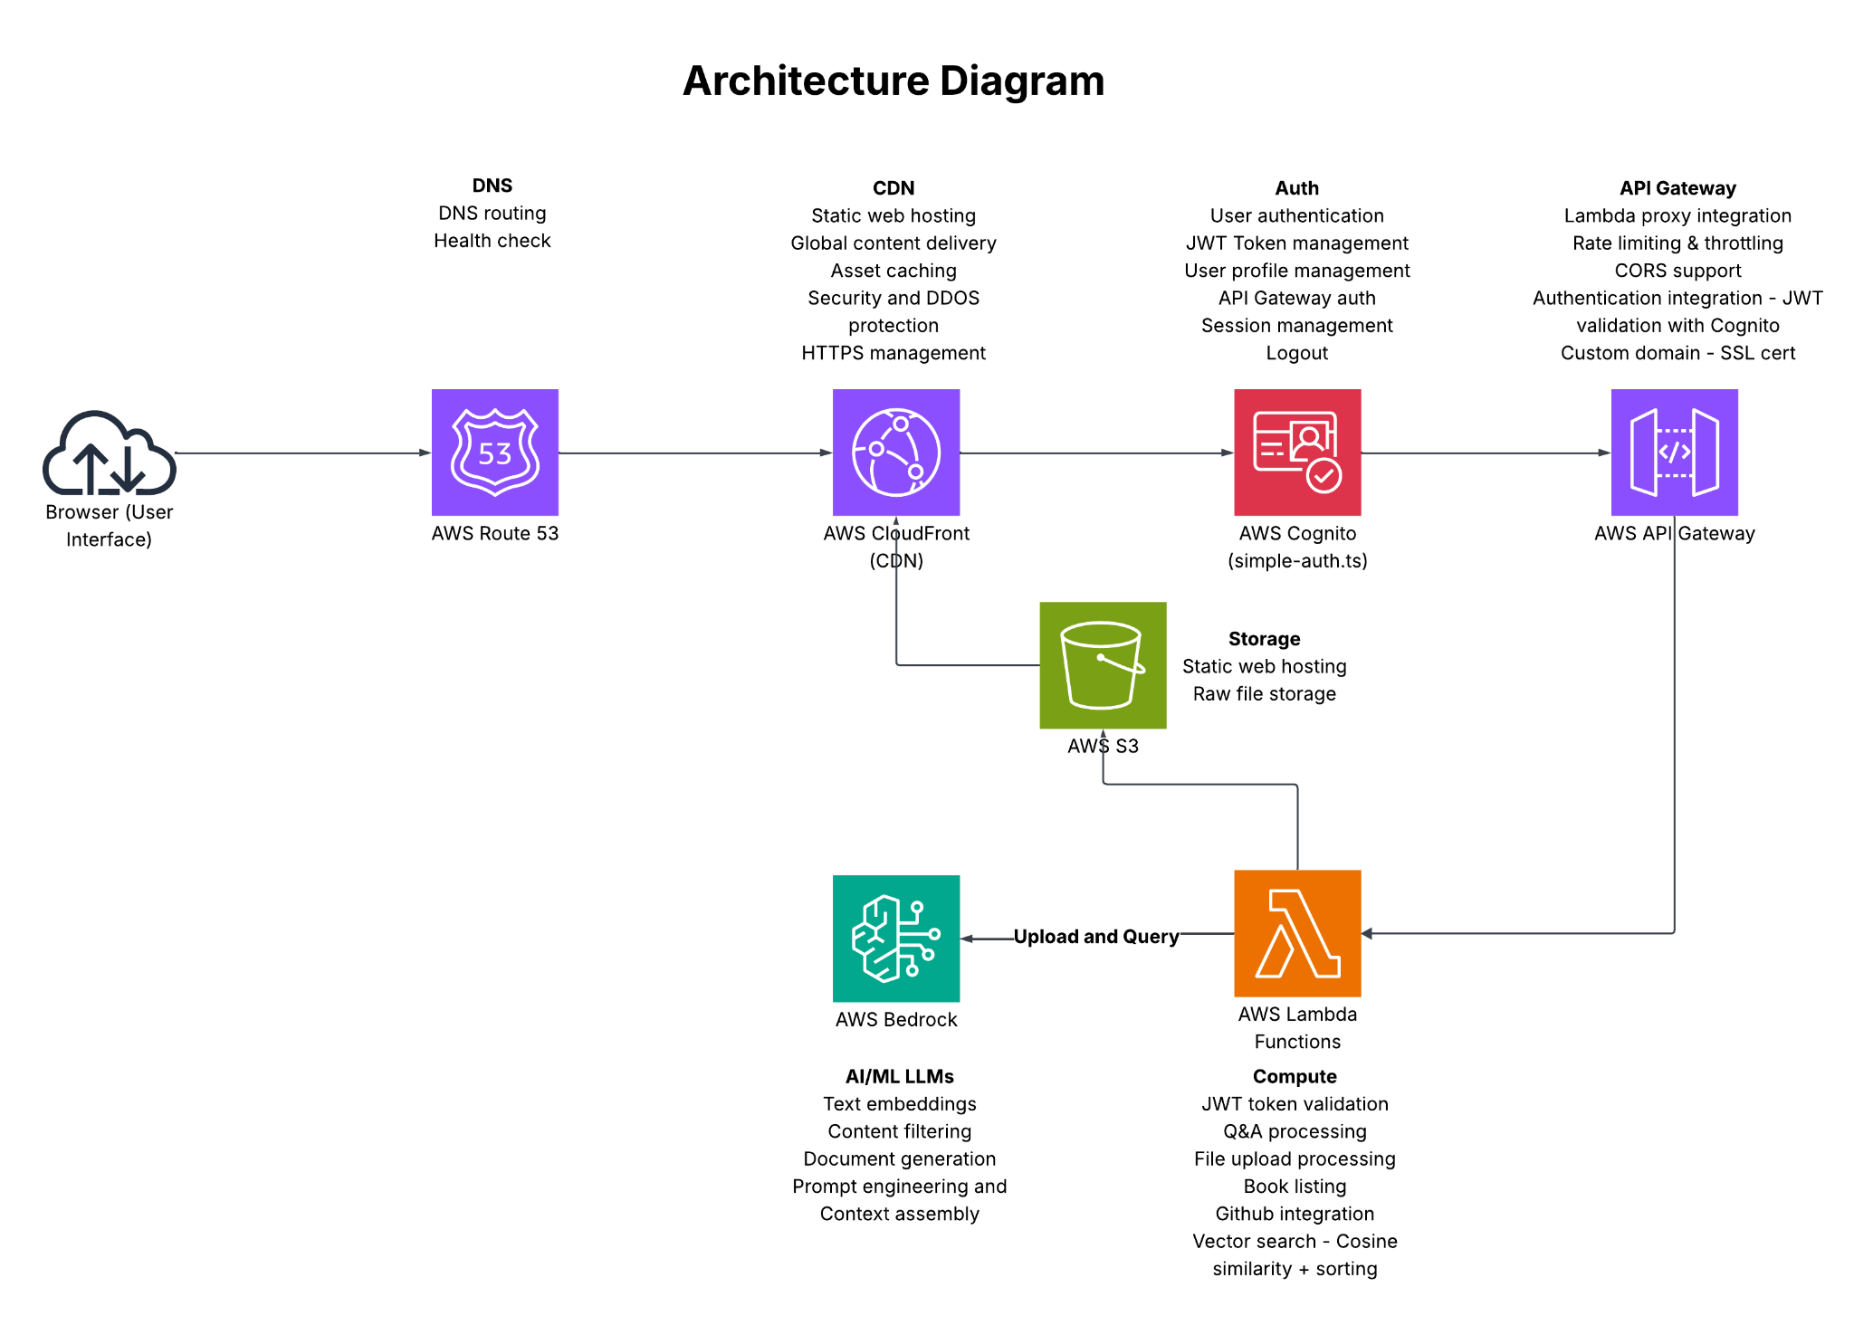
Notes:
For upload flow - a lambda uploads raw file or an open source public github repo into S3, it chunks text, generates embeddings using AWS Bedrock and ingest embeddings into DynamoDB.

Slide 11
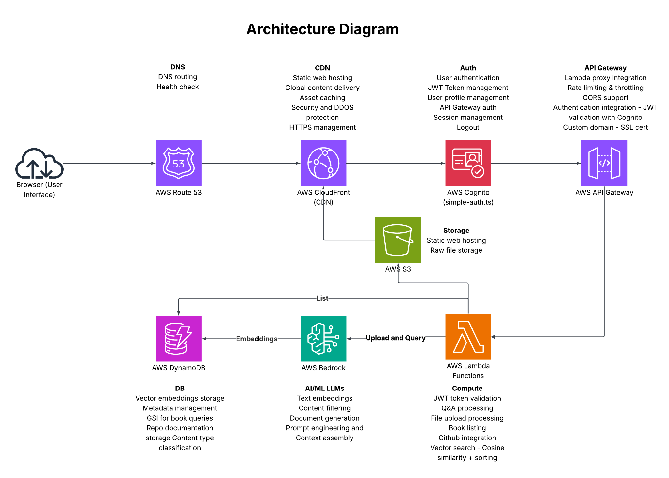
Notes:
For list flow - a lambda lists books or app documentation in S3.
For query flow - a Lambda queries DynamoDB for embeddings and performs vector search by calculating cosine similarity between query and embeddings.
Bedrock generates the final answer using retrieved context, and Lambda returns response through API Gateway

Slide 12
Achieving Enterprise Grade: First Design Decisions
AWS Bedrock
AWS Bedrock
Auto-scaling
Redundancy and 99.999% Availability
No data retention
Pay-per-use
Flexibility with model usage
Auto-scaling
Redundancy and 99.999% Availability
No data retention
Pay-per-use
Flexibility with model usage
Notes:
As a solo developer, making smart architectural choices was critical for building a system that could scale, stay secure, and remain low-maintenance.
These are some of the whys I evaluated before making architectural choices
Amazon Bedrock
I used it for generating Q&A responses and creating high-quality embeddings for semantic search. This allowed me to use powerful LLMs without the hassle of training or hosting models. It offers auto-scaling, five nines of uptime, and is fully managed. The pay-per-call model was very cost-efficient.

Slide 13
Achieving Enterprise Grade: First Design Decisions
AWS Bedrock
S3 +CDN
AWS Bedrock
Auto-scaling
Redundancy and 99.999% Availability
No data retention
Pay-per-use
Flexibility with model usage
Unlimited storage
Redundancy and 99.999% availability
DDoS protection
Pay-per-use
Sub-100ms global latency
Auto-scaling
Redundancy and 99.999% Availability
No data retention
Pay-per-use
Flexibility with model usage
Notes:
S3 + CloudFront (CDN)
Used S3 to Store raw text files of the content and static UI assets. Used CDN to cache the static UI assets. S3 provided unlimited, reliable storage for the documents and assets. CloudFront then pushed this content globally with low latency, ensuring fast access for users worldwide. Both services are fully managed, secure, and operate on a pay-per-use model.

Slide 14
Achieving Enterprise Grade: First Design Decisions
AWS Bedrock
S3 +CDN
API Gateway + Lambda
AWS Bedrock
Auto-scaling
99.95% availability with built-in fault tolerance
Authentication integration
Pay-per-use
Sub-100ms cold starts
Auto-scaling
Redundancy and 99.999% Availability
No data retention
Pay-per-use
Flexibility with model usage
Unlimited storage
Redundancy and 99.999% availability
DDoS protection
Pay-per-use
Sub-100ms global latency
Auto-scaling
Redundancy and 99.999% Availability
No data retention
Pay-per-use
Flexibility with model usage
Notes:
API Gateway + Lambda
I used this combination to build clean REST APIs for the frontend, integrate with Amazon Bedrock, and handle queries and asynchronous file uploads. I chose Python for writing the Lambdas for its rich ecosystem of libraries, which makes tasks like text processing and data manipulation with AWS services very efficient.

Slide 15
Achieving Enterprise Grade: First Design Decisions
AWS Bedrock
S3 +CDN
API Gateway + Lambda
DynamoDB
Auto-scaling
99.95% availability with built-in fault tolerance
Authentication integration
Pay-per-use
Sub-100ms cold starts
Auto-scaling
Redundancy and 99.999% Availability
No data retention
Pay-per-use
Flexibility with model usage
Unlimited storage
Redundancy and 99.999% availability
DDoS protection
Pay-per-use
Sub-100ms global latency
Auto-scaling
Redundancy and 99.999% Availability
Encryption
Pay-per-use
Sub-millisecond latency
Notes:
DynamoDB
I used DynamoDB to store embeddings for semantic search and manage metadata like document titles and user information because its fast performance seemed perfect for vector lookups.
Notice that all these components offer five nines of uptime, are pay-per-use and are fully managed. This enables availability, cost efficiency and maintainability.
However, when I monitored the API response times on Cloudwatch, I noticed high latency of 3-5 seconds for larger books like Indian epics. So started I looking into a cost efficient Vector DB to store, index, and search vector embeddings.

Slide 16
Vector DB
What?
Store, index, and search vector embeddings as numeric arrays.
Why?
Efficient search at large scale.
How?
Specialized indexing, ANN search in millis, Metadata filtering, Hybrid search
When to use?
Semantic search, Chatbots, RAG, Recommendation systems, Image search, Anomaly detection
Notes:
What?
Vector DB is a database designed to store, index, and search vector embeddings. Embeddings are data represented in numeric arrays to enable fast similarity search.
Why?
In AI workflows, we often:
Convert raw data into embeddings using an LLM
Store these embeddings in a DB
And we intend to search them efficiently at a large scale in milliseconds
to find the nearest neighbors
so we can use the retrieved content for - Semantic search and other usecases.
Nearest neighbor search is expensive without specialized indexing.
A Vector DB is optimized for this search at large scale.
How?
Vector DB stores embeddings alongside metadata
Indexes them using different algorithms – like: HNSW (Hierarchical Navigable Small World) graphs, IVF (Inverted File), PQ/OPQ (Product Quantization for compression)
Performs Approximate Nearest Neighbor Search -( Finds the top-k most similar vectors to a query vector fast in milliseconds.)
supports metadata filtering - (since the embeddings are stored alongside metadata,)
also often supports hybrid search ie keyword + semantic search together
When to use?
Semantic Search: Searching for “articles about renewable energy” returns relevant content even without exact keywords.
Chatbots / RAG: Retrieving relevant knowledge snippets for an LLM to answer with context.
Recommendation Systems: Suggesting similar movies, products, or songs.
Image / Video Search: “Find images similar to this one.”
Anomaly Detection: Finding items far from the normal cluster in vector space.

Slide 17
S3 Vectors
Native AWS Integration
Operational Simplicity
Cost Efficiency
Scalability
Metadata Storage
metadata = {
'book_title': book_id,
'chunk_number': int(chunk['chunk_id']),
'chunk_id': chunk['chunk_id'],
'text': chunk['text'] #No need for separate database lookups, text content stored with vectors
}
Performance
response = s3_vectors_client.query_vectors(
queryVector={'float32': query_embedding}, #Native cosine similarity search
topK=top_k * 2,
returnMetadata=True #Get text content in same query
)
Security & Compliance
Notes:
Amazon S3 Vectors is the first cloud object store with native support to store and query vectors.
S3 vectors was release in July 15, 2025. It is not available in all regions the last I checked.
Evaluated S3 Vectors along with other DBs: Pinecone, Chroma, Weaviate, Qdrant
S3 Vectors is optimal for Epic Q&A because it is:
Native to AWS and offers operational simplicity
It integrates seamlessly with existing AWS infrastructure, I can use cloudformation for deployments and has built in monitoring and logging with AWS. It has automatic backups and redundancy. Since it is native to AWS, it doesnt require any external service agreement or installation setup. Whereas the other dbs like Chroma are not managed by AWS. external deployment is required.
Cost Efficiency
It provides cost-effective native vector operations - it operates on Pay per query ie No idle resource charges whereas Other DBs: Pinecone, Weaviate, Qdrant charge for compute instances even when idle
No compute costs for vector operations - unlike the previous solution, Lambdas incurred cost performing vector search by calculating cosine similarity between query and stored embeddings
Storage costs are similar to S3 that we are already using
This reduces cost of uploading, querying and storing data by 90%
Scalability
S3 vectors scales exponentially and offers unlimited storage.
Metadata Storage
It stores rich metadata ie No need for separate database lookups, the chunk text is stored along with vectors.
Performance
S3 has native cosine similarity search and gets text metadata content in the same query
After migrating from DynamoDB to S3 vectors, the performance has improved multifold. the APIs got 83.3% faster.
[Improvement %=(Old Time−New Time​)×100/Old Time]
Offers native AWS security and compliance:
Requires minimal operational overhead

Slide 18
Notes:
This is the old Architecture that has Lambdas doing the vector search with cosine similarity and ranking on DynamoDB.

Slide 19
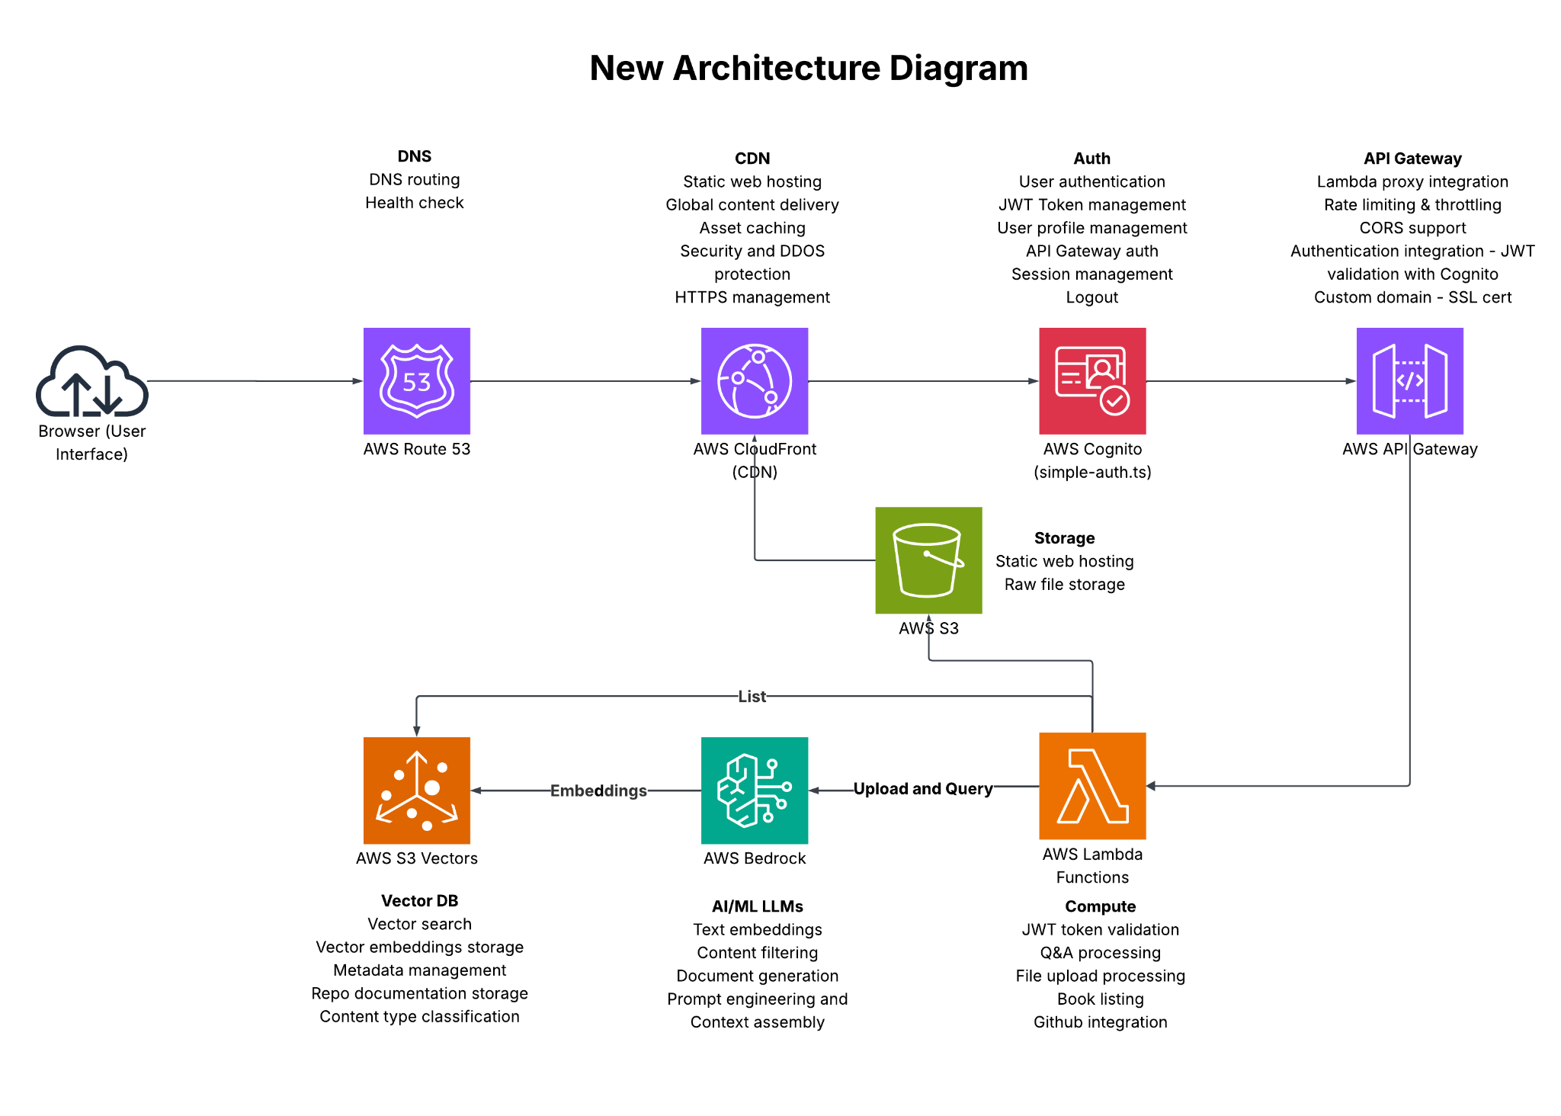
Notes:
This is the new Architecture using S3 vectors as Vector DB. In the previous architecture, Lambdas performed vector search by calculating cosine similarity between query and stored embeddings and ranking the responses. S3 vectors here stores and indexs embeddings and offers native cosine similarity search optimized for vector operations, hence Lambdas dont have the overhead of the calculations.

Slide 20
Observability & Evals
Cloudwatch metrics and automatic dashboards
Latency - ~200ms (native search) - 60-70% reduction
Throughput - ~1000+ QPS (native scaling) - 5-7x increase
Error rate - 2-3% - 80% reduction in Lambda timeouts
Duration - ~200ms - 60-70% reduction in Lambda runtime
Tensorboard metrics for model quality
Accuracy 6% improvement
Precision 8% improvement
Notes:
With the new Architecture
Evaluated the app for a sample data of 10 books of different sizes and 10 code repositories.
Performed load testing simulating user activity using Apache Jmeter.
Monitored Cloudwatch for latency, throughput, error rate, and duration for Lambdas
Also monitored Tensorboard metrics for evaluating model quality for accuracy and precision.
these are the numbers after moving from Dynamodb to S3 vectors

Slide 21
Achieving Enterprise Grade: Design Decisions
System Design Principle | Key Technologies & Concepts
Modularity | Lambda Functions, API Gateway
Scalability | S3 + CDN , API Gateway + Lambda , S3 Vectors
Reliability | AWS Managed Services, Automatic Retries, Automatic backups and redundancy
Security | IAM Roles, S3 Data Encryption (at-rest/in-transit)
Flexibility | Bedrock (multi-LLM), Lambda Modular Code
Cost-Effectiveness | All services Pay-per-Use, No Idle Costs, S3 Tiered Storage, CDN Caching
Maintainability | Infrastructure as Code, Managed Services, Automated Monitoring
Testability | Isolated Components, Unit Tests
Reusability | Lambda Layers, CloudFormation Templates, Shared Code
Observability | LangSmith (Request-level tracing), Cloudwatch logs and dashboard
Evaluation | Tensorboard, Cloudwatch metrics (Latency, Throughput, Scalability - AWS-native metrics)
Notes:
Let us revisit our System Design Principles -
Modularity is achieved by having a separate api endpoints connecting to a different lambda for each operation like authentication, query, list, upload
Scalability is achieved by having serverless architecture and auto scaling - the combination of S3 + CDN & API Gateway + Lambda. The app is completely serverless and scales automatically from zero to thousands of requests without a single server to manage.
Reliability - AWS offers automatic retries for lambdas, automatic backups and redundancy for S3
Security - Data is encrypted at rest and transit. IAM roles follow the principle of least privilege - each role only has the exact permissions needed. API gateway used rate limiting and throttling. And Authentication is integrated into each component ie with Cognito JWT Token validation and Lambda execution roles enabling security.
Flexibility - flexibility to choose the model based on operation in AWS Bedrock, and modular code- ie to migrate from DynamoDB to S3 vectors - all I had to change were the lambdas and lambda execution roles to give access to S3 Vectors.
Cost-Effectiveness - we briefly already looked into this, all components are Pay-per-Use, CDN Caching will reduce number of origin requests. Cost of uploading, querying and storing is reduced by 90% from before by using S3 vectors.
Maintainability - Infrastructure as Code (Cloudformation templates, patch scripts with aws cli), using fully Managed AWS Services, Automated Monitoring using Cloudwatch
Testability - all the api gateways, and lambdas can be tested independently, the react code and the python code are tested with unit tests and integration tests.
Reusability - the architecture itself can be reused for multiple purposes like any RAG Chatbots, Document Q&A systems, Content recommendation systems, Knowledge management platforms, and AI powered search systems.
Observability and evaluation
as we saw in the previous slide, the new architecture has Better observability and evaluation with performance metrics due to native vector search operations on AWS.

Slide 22
AI Risks and mitigations
AI Risk | Mitigation Strategy | Implementation
Hallucination | Source-Grounded Responses | RAG Pattern- Every answer grounded in source chunks stored in S3 Vectors with metadata
Lack of Context | Semantic Search | Titan embeddings for meaning-based retrieval with S3 Vectors native cosine similarity
Security & Privacy | VPC and Encryption | VPC isolation, encryption, least-privilege IAM
Bias in training data | Document Isolation | Complete document isolation, no cross-contamination
Explainability | Source Attribution | Source attribution, chunk tracking, audit trails
Performance | Asynchronous Processing | Async processing, optimized chunking, S3 Vectors auto-scaling, native vector operations
Reliability | AI powered Content filtering | Ensures AI responses are appropriate, context-aware filtering, extensible to add additional context types
Notes:
One of the biggest differences between a prototype and an enterprise-grade system is how you handle the inherent risks of AI. By proactively addressing these issues in the architecture, I was able to build a system that is not only functional but also trustworthy and reliable.
[TIME CHECK]
[Hallucination: we are preventing these by enforcing a Retrieval-Augmented Generation (RAG) pattern. Every API response from S3 vectors has the relevant chunk text.
Lack of Context: We are preventing this by using semantic search. A user's question is turned into a vector embedding using Amazon Bedrock's Titan Embeddings, and then find the most relevant chunks of that specific document based on meaning.
Security & Privacy: Already spoke about this in the previous slide, [All data is encrypted at rest and in transit. User documents are completely isolated from each other.]
Bias in Training Data: documents are completely isolated from each other. The model's knowledge is intentionally limited to the documents provided, preventing it from pulling in potentially biased information from its original training set.
Explainability: Each answer includes source attribution, ie API response from S3 vectors has the relevant chunk text. This builds trust and allows for easy verification.
Performance: Im using asynchronous processing and optimized chunking with overlaps for large file uploads. Also we saw previous slides that S3 Vectors have native vector search that reduced the latency.
Reliability - added Content filtering to filter any in appropriate responses extensible to add additional context types]

Slide 23
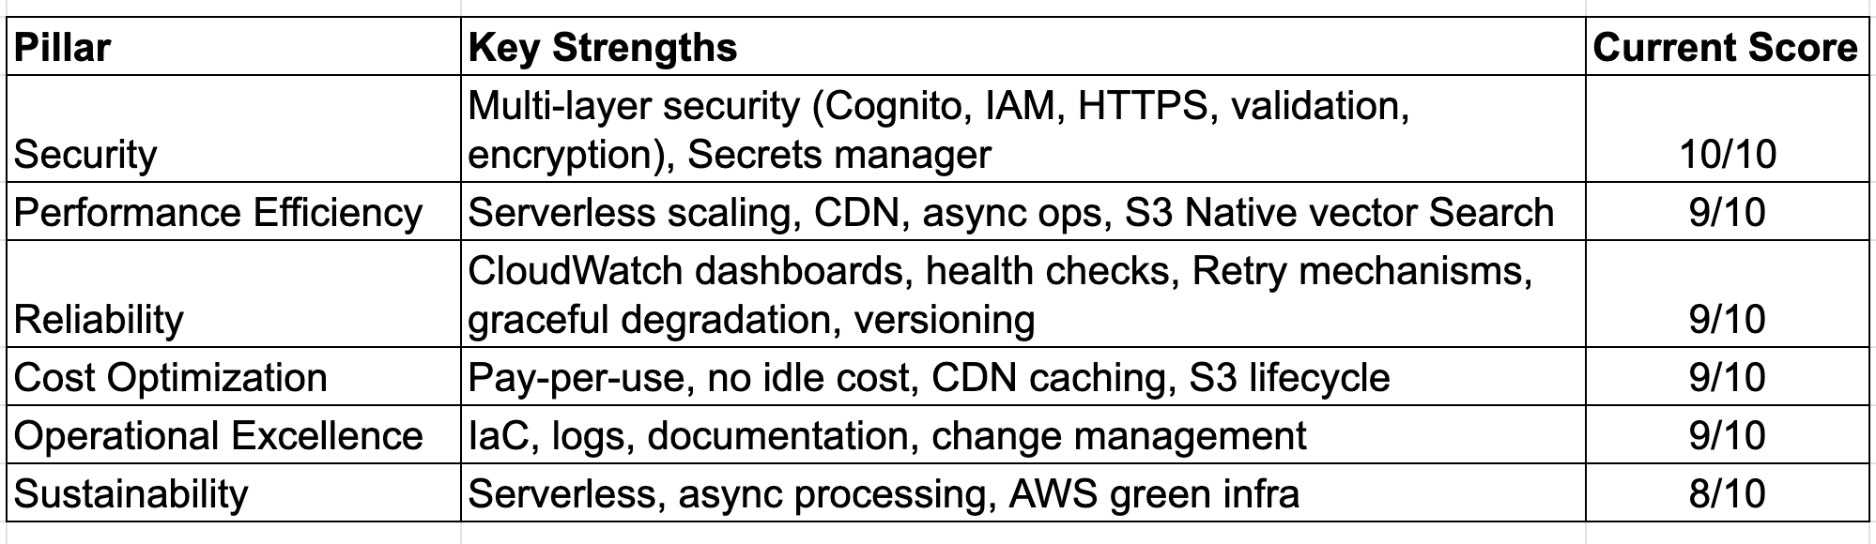
AWS Well Architected framework
Total Score 54/60 - A+
Notes:
The AWS Well-Architected Framework is a set of best practices for building and operating cloud workloads on AWS, focusing on the 6 pillars - Security, Performance Efficiency, Reliability, Cost Optimization, Operational Excellence, and Sustainability. It provides a structured way to evaluate and improve cloud architectures, helping teams build enterprise grade systems. This is the score of the architecture evaluation based on the best practices. We have already looked into how we achieved each of these in the previous slides.
[Security (10/10): I built a multi-layered defense with encryption, IAM, and Secrets Manager. Our perfect score reflects a proactive approach to protecting data from the start.
Performance Efficiency (9/10): The system scales automatically with demand using serverless and a global CDN. Asynchronous operations and intelligent indexing keep performance high and latency low.
Reliability (9/10): I designed for resilience with built-in retry mechanisms and graceful degradation. CloudWatch dashboards and health checks allow us to proactively monitor and maintain system uptime.
Cost Optimization (9/10): Our pay-per-use serverless model has no idle costs, and we use smart caching and S3 lifecycle policies to keep expenses to a minimum.
Operational Excellence (9/10): The entire infrastructure is managed as code (IaC), with centralized logging and monitoring. This automates deployments and ensures our processes are consistent and repeatable.
Sustainability (8/10): The serverless architecture is inherently green, as it only uses resources when needed. This approach, combined with efficient asynchronous processing, minimizes our environmental footprint.
]

Slide 24
Accelerating Velocity with AI Tools
Eraser io and Lucid Charts
Cursor
Google Gemini
Peer programming-
Python for Lambdas
React / Typescript for UI
Cloudformation
AWS cli for IaC
Debugging
Documentation
Content summarization for architecture diagrams & presentation
Whiteboarding
Diagram generation based on content
Notes:
Accelerating Velocity with AI Tools
As a solo developer, my biggest challenge was time. To overcome this, I co-developed with AI tools like Cursor.
I used Cursor as my pair programmer, helping me write boilerplate code, debug complex functions, and refactor entire modules. generate unit tests and documentation.
I used Eraser.io and Lucid charts for transforming my initial rough notes on architecture into detailed architectural diagrams in minutes with documentation and md files generated by Cursor.

Slide 25
Key Cursor Features That Accelerated This Project
Agent mode
Contextual symbols
TDD
@Docs @Web
.cursorrules
Model selection
Sonarlint integration
Be mindful of hallucinations
Notes:
These are some of the cursor features that I had used for this project
Agent mode Used Cursor's agent mode to automatically generate initial code for Lambda functions, and cloud formation templates for deployment
Contextual symbols Referenced code with @ symbols to provide context about existing Lambda functions when prompting for modifications
TDD Implemented Test-Driven Development by writing tests first based on the requirement prompts.
@Docs @Web Used @Web to search for latest AWS S3 Vectors documentation and @Docs to reference Bedrock API documentation and AWS S3 Vectors documentation when implementing new features
.cursorrules Created project-specific rules for code style, AWS best practices, and security requirements to ensure consistent code quality across Lambda functions
Model selection Chose appropriate AI models within Cursor for different tasks: code generation and documentation.
Sonarlint- Integrated SonarLint to automatically detect security vulnerabilities, code smells, and maintain code quality standards in the Python Lambda functions
Hallucinations - since Cursor is an AI tool, it may hallucinate and generate incorrect responses. Need to review the code changes each time intently.
[It may
use non-existent methods or libraries,
incorrectly expand abbreviations during documentation.
call existing functions with invalid arguments or unsupported patterns.
oversimplify or over-complicate code during refactoring.]

Slide 26
Building Big with a Team of One
☕ Costs less than a cup of coffee
📈 Scales to thousands in seconds
🔐 Enterprise-grade security
🧑‍🚀 Team of one, roles of many
🤖 Co-built with AI tools
🚀 From prototype to production ready
Notes:
So, I addressed all the Claims I made in my introduction - ie building Secure, Scalable, Enterprise grade AI system Solo with optimized Cost
☕ Costs less than a cup of coffee a day
Serverless architecture + Bedrock = production-grade AI on a budget
📈 Scales to thousands in seconds with
Lambda, S3 vectors
🔐 Enterprise-grade security with Cognito, IAM, encrypted storage, API Gateway hardening — baked in from day one
🧑‍🚀 Team of one, roles of many Architect, PM, Dev, Ops, QA — all in one. And yes, it was fun.
🤖 Co-built with AI tools like Cursor,
🚀 From prototype to production ready code

Slide 27
Key takeaways
Clearly define the problem
Prioritize System Design
Embrace Serverless
Co-Develop with AI
Measure everything
Notes:
Key Takeaways for You
So, what can you take away from my experience?
Clearly define the problem: the scope and business impact of the solution.
Prioritize System Design: A well-architected system is more than just code. It's about security, scalability, and all the system design principles we spoke about. Start with a solid blueprint and build on it.
Embrace Serverless: Stop paying for idle servers.
Co-Develop with AI: Integrate tools like Cursor, and Github Copilot.
Measure everything: monitor and evaluate the system and iterate with improvements
In conclusion, the journey from a simple idea to a full-fledged enterprise-grade AI system is challenging, but it's entirely possible for a solo developer. It requires a combination of modern tools, smart architectural decisions, and a passion for solving real problems.

Slide 28



Thank You!
https://www.linkedin.com/in/soujanyavullam/
Notes:
Thank you, everyone!
if you have any Questions about this project? Please feel free to contact me on Linkedin.

